Slide 1
UNIT 11
SOHO NETWORK & MULTIPLAYER NETWORK

Slide 2
What is a computer network
A computer network is a set of connected computers. Computers on a network are called nodes. The connection between computers can be done via cabling, most commonly the Ethernet cable, or wirelessly through radio waves. Connected computers can share resources, like access to the Internet, printers, file servers, and others. A network is a multipurpose connection, which allows a single computer to do more.

Slide 3
Uses and features of computer networks
The uses of sharing hardware resources for a business that have different offices around the globe is a major advantage it allows them to share files also work on the same files, share information securely within the firm, increasing the productivity. Also Businesses can save money by purchasing one software licence and sharing it with all the computer hardware in the firm.
Communication methods like instant messaging and social networking allows firms to hold meeting without having their employees travelling to the meeting location saving the business money.
Businesses can save money on telephone bills if they make all their calls on an application like Skype.

Slide 4
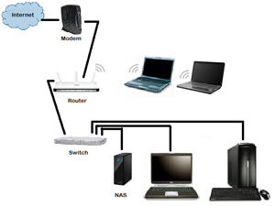
SOHO NETWORK
SOHO ( small office home office) it’s a local area network connection usually used in small businesses, like many other LANS, SOHO network can be a mixture of wireless and wired connections.
The purpose of SOHO network is to connect no more than 15 computers and devices on a single network and share the information and resources between them those can be printers, applications and storage.
The clients can then communicate with each other by sending e-mails or using VOIP (Voice over internet protocol)
Notes:
SLA Service level agreement
Source : http://www.examcollection.com/certification-training/network-plus-soho-network-requirements-planning-and-implementation.html

Slide 5
SOHO NETWORK Features
Security
Prevent unauthorized access to programs and data by means of password, Firewall and software applications.
File management
Manage the resources and decides who gets the resources
Device management
Keeps track of all devices connected to network and manage them example blocking some site for some users
Level of Access
Read only (Users can only read files)
Read and write(Users can read and edit files but they cannot delete it or move it)
Full Control (The User have full control on the files he can edit, write, and delete)

Slide 6
Strengths and weaknesses of SOHO NETWORK
Strength:
Sharing devices such as printers
Sharing files between users
Security, users cannot see other users files unlike on stand-alone
Can be wireless
Weakness:
Wireless connection is slower than wired
If the router breaks down sharing files with other devices will not be possible
Viruses can spread to other computers throughout the network

Slide 7



Multiplayer Gaming Network

Slide 8
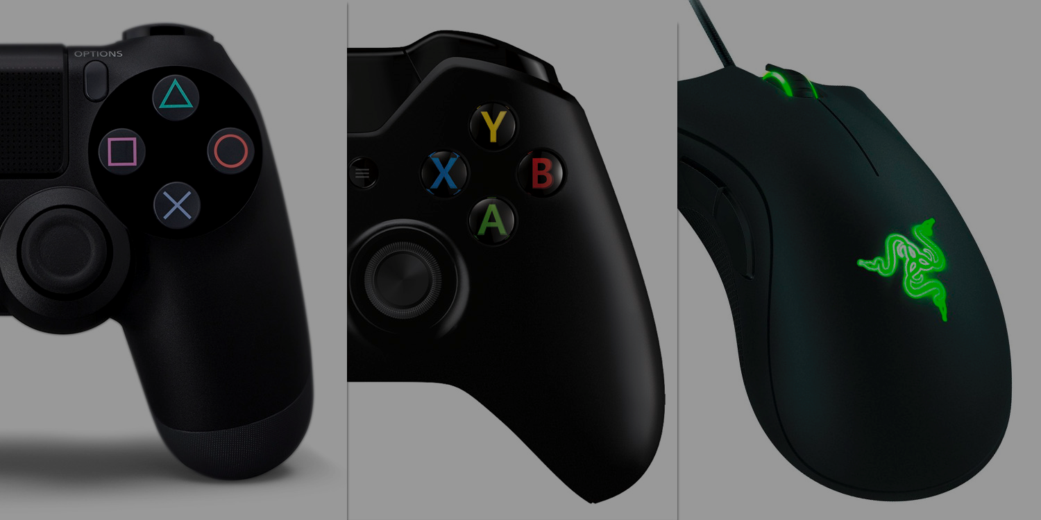
Multiplayer Gaming Network
A multiplayer gaming network uses a client-server architecture, the server usually is the host that runs the games and player input processing, a client is the player computer connected to a game server. The client and server communicate with each other by sending small data packets at a high frequency (usually 20 to 30 packets per second) A client receives the current world state from the server and generates video and audio output based on these updates. The client also samples data from input devices (keyboard, mouse, microphone, etc.) and sends these input samples back to the server for further processing. Client only communicate with the server not between them.

Slide 9
Multiplayer network
High demanding games requires more data to be transferred over the network having a slow connection to the internet can seriously affect the user experience, like slow response from the player input and the action being carried out on the screen, also downloading time can be affected by slow connection.

Slide 10
Multiplayer gaming network strength and weakness
The strength of multiplayer gaming network is that it allows players to play with each other worldwide, connecting them together and socializing allowing them to share gameplay or screen shots. The weakness is having to choose between one platform from another like an Xbox ,PlayStation or Nintendo each of them offer the same service but they do not share the same library of games, so multiplayer gaming are not possible between two different console, even if the game is available for both Xbox and PlayStation you cannot play together, because they don’t support cross platform play, in the pas both have been hacked and multiple account and password have been stolen forcing users to change the account or having it suspended, some time the servers are jammed because the are too many clients connected to their servers than it can handle.

